Slide 1

MQTT security
The Internet of Things
Guillermo Ramirez Prado
April 2024

Slide 2
There are different kinds of data, which are not meant for the public and should be protected.
Basics of information security:
Confidentiallity
Integrity
Availability

Slide 3
Approach to security in MQTT
Security in MQTT is divided in multiple layers
As in every communication protocol, state-of-the-art security
standards are used.
The big picture:
Network level
Transport level
Application level
There are a lot of options on the protocol to have a secure communication

Slide 4
Transport and application layer
MQTT Authentication with username and password
The CONNECT frame message provides username and password fields
(The protocol itself has Authentication defined)
Password can be up to 65535 chars long.
You can have:
No user, no password
User, no password
User and password

Slide 5
Authentication

Slide 6

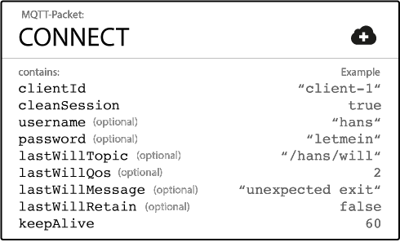

Slide 7
Built in authentication mechanism will return one of the next return codes:
Return Code | Return Code Response
0 | Connection Accepted
4 | Connection Refused, bad user name or password
5 | Connection Refused, not authorized

Slide 8
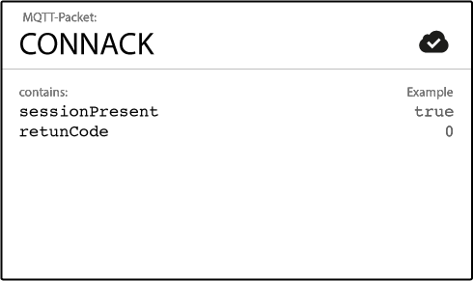

Slide 9
BUT…
When setting username and password on the client, it will be sent to
the broker in clear text
So, the only way to guarantee a completely secure transmission of username and password is to use transport encryption

Slide 10
Advanced Authentication mechanisms
Besides username and password, MQTT clients provide additional information which can be used for authentication
Client Identifier (65535 characters)
X.509 Certificate (Transport level security)

Slide 11
Authorization

Slide 12
Authorization
Giving rights to a resource
Authorization is important for restricting access and allowing only eligible persons, clients or subjects to access certain resources, data or things

Slide 13
A MQTT client can basically do two things after it has connected to a broker.
The MQTT client is the subject.
The topics are the resources
Other objects: Store Last Will and Testament or have a persistent
session
Main resources to protect are the ability to publish or subscribe

Slide 14
In order to restrict a client to publish or subscribe only to topics it is authorized to, it is necessary to implement topic permissions on the broker side. These permissions need to be configurable and adjustable during the runtime of the broker. A topic permission could for example look like the following:
Allowed topic (exact topic or wild card topic)
Allowed operation (publish, subscribe, both)
Allowed quality of service level (0, 1, 2, all)
Some good practices include having topics defined on paths:
gprado/Unitec/ISCG8052/2020S1/bldg183/room2104/temp

Slide 15
Transport Encryption
TLS (Transport Layer Security) and SSL (Secure Sockets Layer) provide a secure communication channel between a client and a server.
TLS and SSL are cryptographic protocols which use a handshake mechanism to negotiate various parameters to create a secure connection between the client and the server.
After the handshake is completed, an encrypted communication between client and server is established and no attacker can eavesdrop any part of the communication.
Servers provide a X509 certificate, typically issued by a trusted authority, which clients use to verify the identity of the server.

Slide 16
MQTT and TLS
MQTT relies on TCP as transport protocol, which means by default the connection does not use an encrypted communication. To encrypt the whole MQTT communication, most many MQTT brokers – like HiveMQ – allow to use TLS instead of plain TCP. If you are using the username and password fields of the MQTT CONNECT packet for authentication and authorization mechanisms, you should strongly consider using TLS.
Port 8883 is standardized for a secured MQTT connection. The standardized name at IANA is “secure-mqtt” and port 8883 is exclusively reserved for MQTT over TLS.

Slide 17
MQTT Payload encryption

Slide 18
MQTT Payload encryption
MQTT Payload encryption is the encryption of application specific data (typically the MQTT PUBLISH packet payload or the CONNECT LWT payload ) on the application level.
This approach allows End-to-End encryption for application data even for untrusted environments.
While the message metadata like the MQTT Topic stays intact, the payload of the message gets encrypted.
This type of encryption is not defined in the MQTT specification and is completely application specific.

Slide 19
Payload encryption is, in general, only applied to MQTT PUBLISH packets. One may write a custom broker plugin which can decrypt the encrypted data on the broker side. And you may encrypt:
PUBLISH topics
CONNECT username / password
SUBSCRIBE topics
UNSUBSCRIBE topics

Slide 20
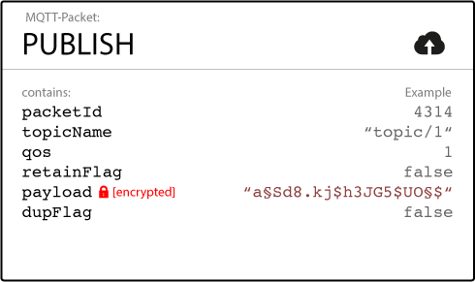

Slide 21
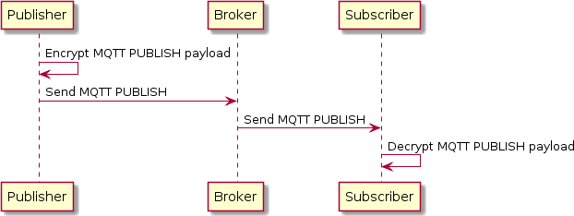
Encryption scenarios
End-to-End (E2E) encryption

Slide 22
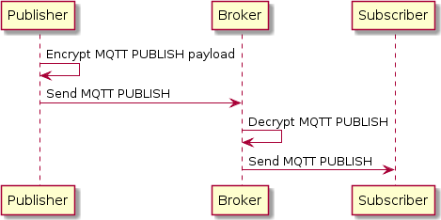
Client-to-Broker

Slide 23
Encryption mechanisms
Asymmetric encryption (Public / Private Key encryption)
Symmetric encryption

Slide 24
Activity
MQTT Mosquitto broker with SSL/TLS transport security

Slide 25
References
http://www.hivemq.com/blog/mqtt-security-fundamentals/

